Slide 1
Section 1.1
Linear Equations
Copyright © 2012 Pearson Education, Inc. Publishing as Prentice Hall.

Slide 2
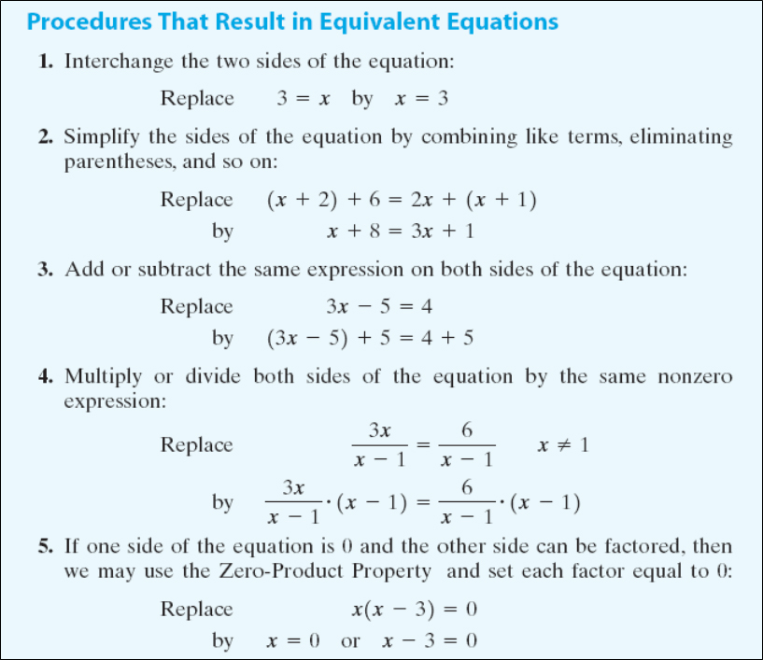
Copyright © 2012 Pearson Education, Inc. Publishing as Prentice Hall.

Slide 3


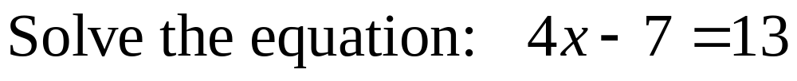
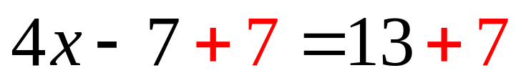
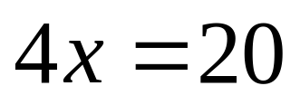
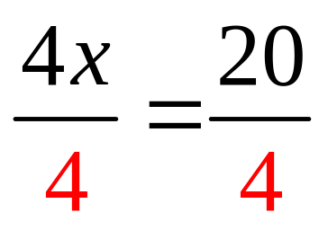
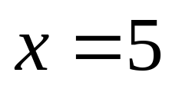
Copyright © 2012 Pearson Education, Inc. Publishing as Prentice Hall.

Slide 4
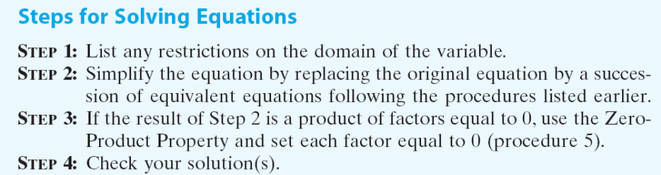
Copyright © 2012 Pearson Education, Inc. Publishing as Prentice Hall.

Slide 5

Copyright © 2012 Pearson Education, Inc. Publishing as Prentice Hall.

Slide 6

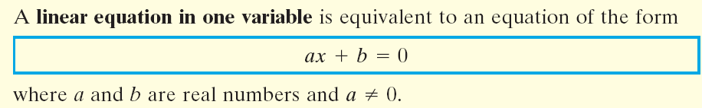
Copyright © 2012 Pearson Education, Inc. Publishing as Prentice Hall.

Slide 7

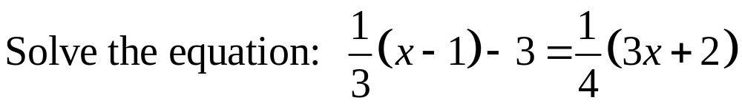
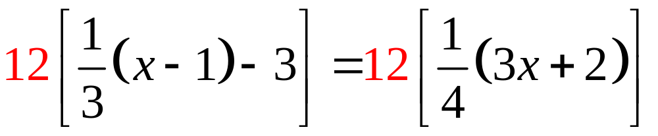
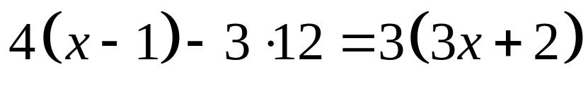


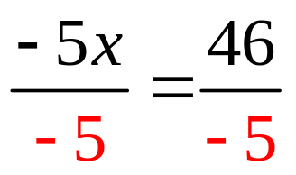
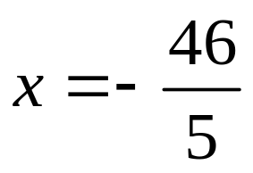

Copyright © 2012 Pearson Education, Inc. Publishing as Prentice Hall.

Slide 8
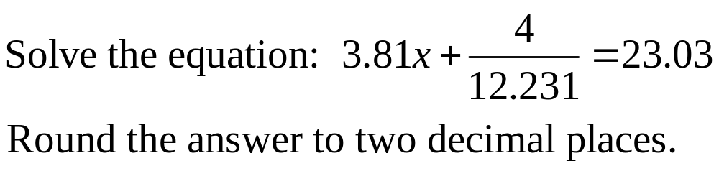
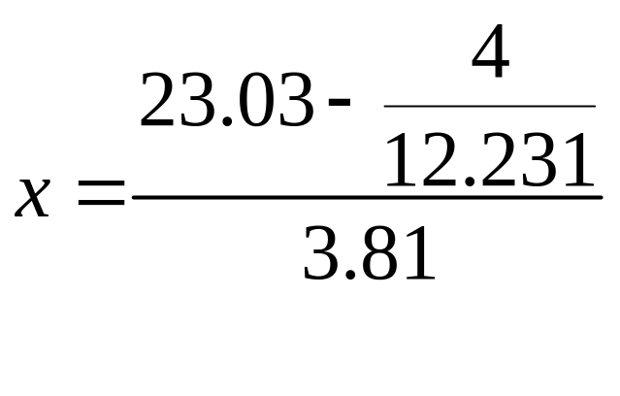
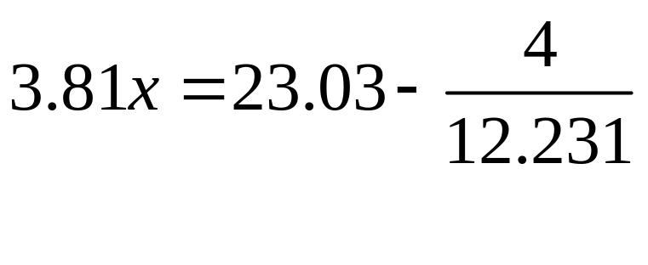

Copyright © 2012 Pearson Education, Inc. Publishing as Prentice Hall.

Slide 9
Copyright © 2012 Pearson Education, Inc. Publishing as Prentice Hall.

Slide 10
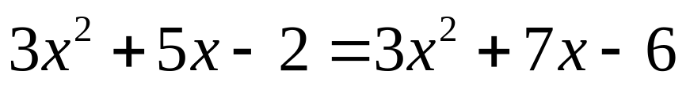




Copyright © 2012 Pearson Education, Inc. Publishing as Prentice Hall.

Slide 11
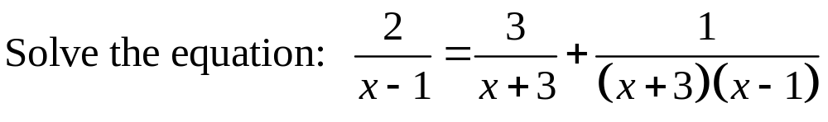
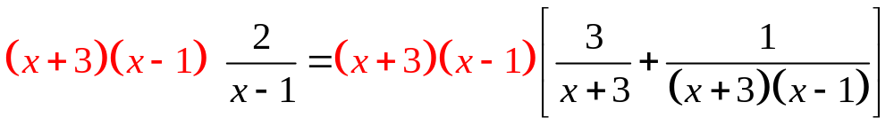
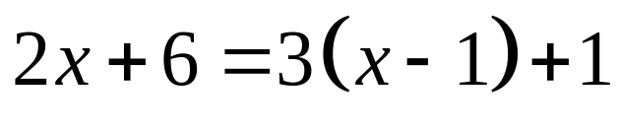



Copyright © 2012 Pearson Education, Inc. Publishing as Prentice Hall.

Slide 12
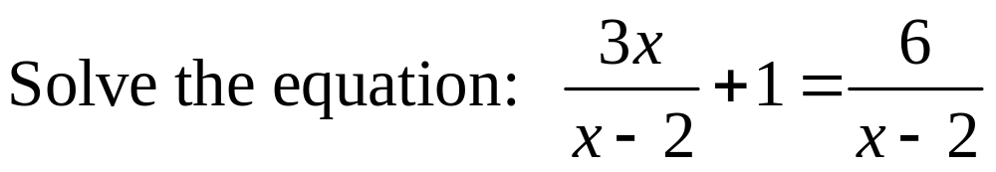
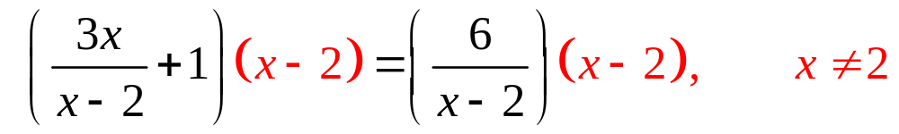
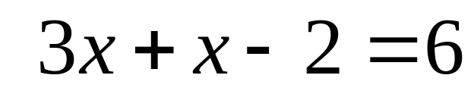
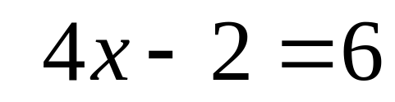
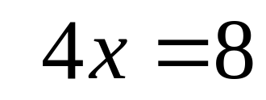
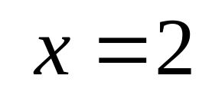
no solution
Copyright © 2012 Pearson Education, Inc. Publishing as Prentice Hall.

Slide 13
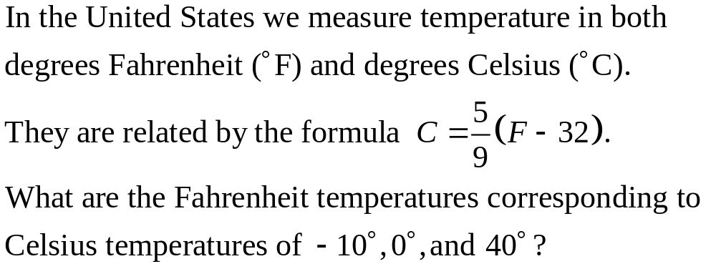
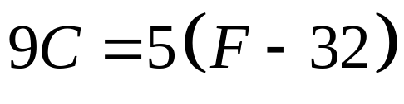


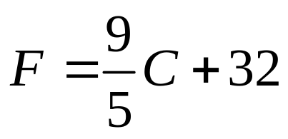
Copyright © 2012 Pearson Education, Inc. Publishing as Prentice Hall.

Slide 14
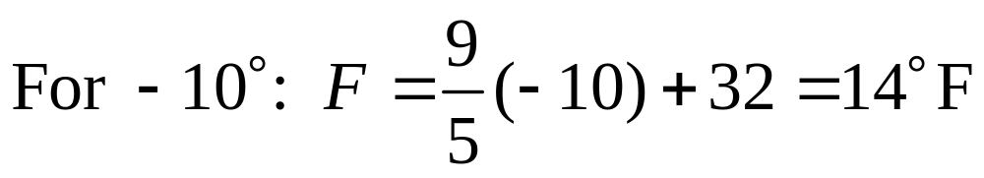
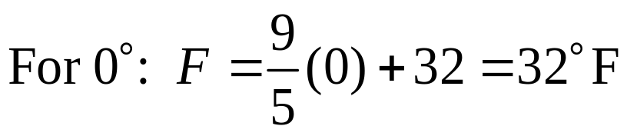
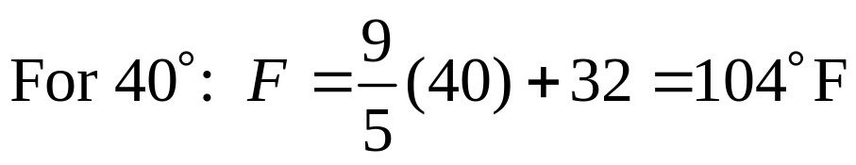
Copyright © 2012 Pearson Education, Inc. Publishing as Prentice Hall.

Slide 15
Copyright © 2012 Pearson Education, Inc. Publishing as Prentice Hall.

Slide 16
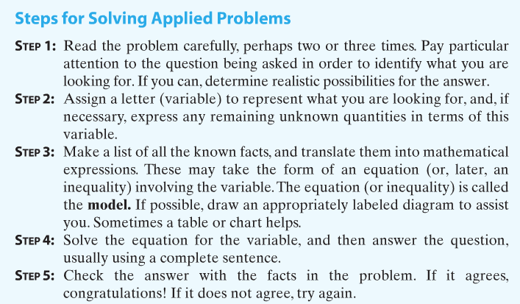
Copyright © 2012 Pearson Education, Inc. Publishing as Prentice Hall.

Slide 17

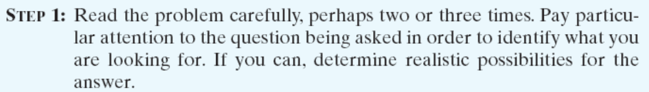
A total of $16,000 is invested, some in stocks and some in bonds. If the amount invested in bonds is one fourth that invested in stocks, how much is invested in each category?
We are being asked to find the amount of two investments. These amounts total $16,000.
Copyright © 2012 Pearson Education, Inc. Publishing as Prentice Hall.

Slide 18

A total of $16,000 is invested, some in stocks and some in bonds. If the amount invested in bonds is one fourth that invested in stocks, how much is invested in each category?
If x equals the amount invested in stocks, then the rest of the money, 16,000 – x, is the amount invested in bonds.
Copyright © 2012 Pearson Education, Inc. Publishing as Prentice Hall.

Slide 19
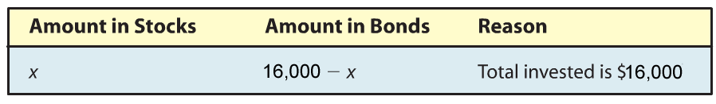

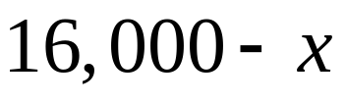

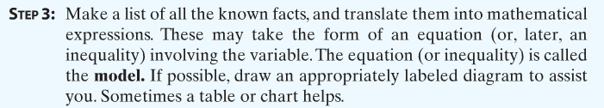
A total of $16,000 is invested, some in stocks and some in bonds. If the amount invested in bonds is one fourth that invested in stocks, how much is invested in each category?
We also know that:
Total amount invest in bonds is one fourth that in stocks
Copyright © 2012 Pearson Education, Inc. Publishing as Prentice Hall.

Slide 20
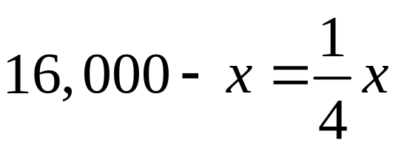
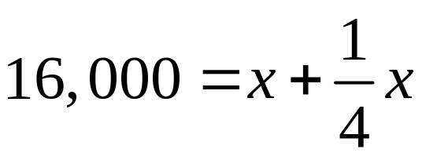
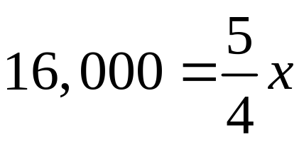
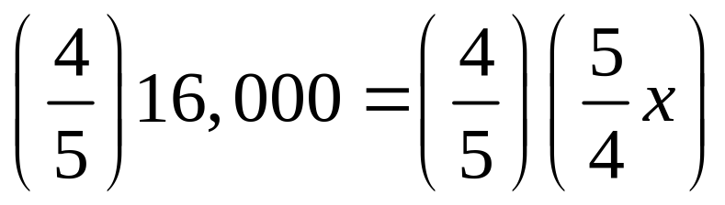

A total of $16,000 is invested, some in stocks and some in bonds. If the amount invested in bonds is one fourth that invested in stocks, how much is invested in each category?
So $12,800 is invested in stocks and $16,000 – $12,800 = $3,200 is invested in bonds.
Copyright © 2012 Pearson Education, Inc. Publishing as Prentice Hall.

Slide 21
A total of $16,000 is invested, some in stocks and some in bonds. If the amount invested in bonds is one fourth that invested in stocks, how much is invested in each category?
The total invested is $3,200 + $12,800 = $16,000 and the amount of bonds, $3,200 is one fourth of that of stocks, $12,800.
Copyright © 2012 Pearson Education, Inc. Publishing as Prentice Hall.

Slide 22
Andy grossed $440 one week by working 50 hours. His employer pays time-and-a-half for all hours worked in excess of 40 hours. What is Andy’s hourly wage?
We are looking for an hourly wage. Our answer will be expressed in dollars per hour.
Copyright © 2012 Pearson Education, Inc. Publishing as Prentice Hall.

Slide 23
Andy grossed $440 one week by working 50 hours. His employer pays time-and-a-half for all hours worked in excess of 40 hours. What is Andy’s hourly wage?
Let x represent the regularly wage; x is measured in dollars per hour.
Copyright © 2012 Pearson Education, Inc. Publishing as Prentice Hall.

Slide 24
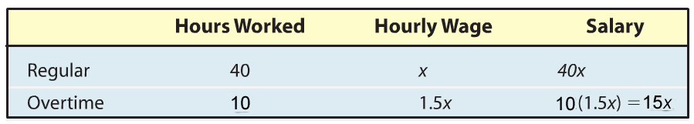
Andy grossed $440 one week by working 50 hours. His employer pays time-and-a-half for all hours worked in excess of 40 hours. What is Andy’s hourly wage?
The sum of regular salary plus overtime salary will equal $440. From the table, 40x + 15x = 440.
Copyright © 2012 Pearson Education, Inc. Publishing as Prentice Hall.

Slide 25
Andy grossed $440 one week by working 50 hours. His employer pays time-and-a-half for all hours worked in excess of 40 hours. What is Andy’s hourly wage?
40x + 15x = 440
55x = 440
x = 8
Andy’s regularly wage is $8.00 per hour.
Copyright © 2012 Pearson Education, Inc. Publishing as Prentice Hall.

Slide 26
Andy grossed $440 one week by working 50 hours. His employer pays time-and-a-half for all hours worked in excess of 40 hours. What is Andy’s hourly wage?
Forty hours yields a salary of 40(8.00) = $320.00 and 10 hours overtime yields a salary of 10(1.5)(8.00) = $120.00 for a total of $440.00.
Copyright © 2012 Pearson Education, Inc. Publishing as Prentice Hall.

Slide 27
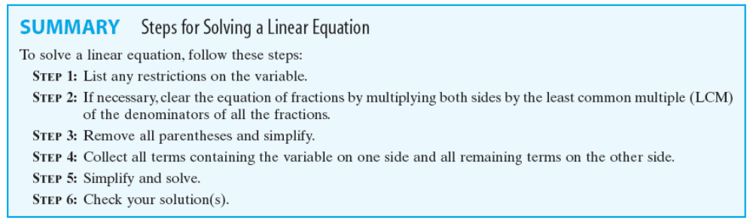
Copyright © 2012 Pearson Education, Inc. Publishing as Prentice Hall.

